Slide 1
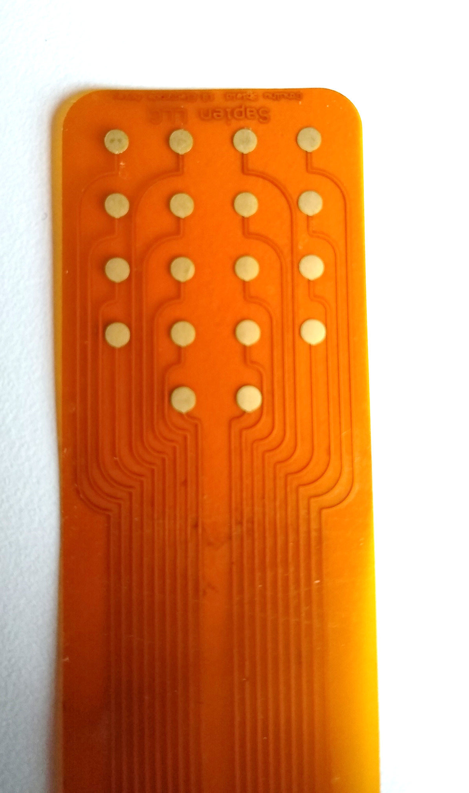
Up
Use the tip of your tongue to touch different electrodes
Left
Right
Down
Touching and holding different electrodes will cause the computer cursor to move in that direction.

Slide 2

Press and hold the tip of your tongue to the back two electrodes to move the cursor up!

Slide 3
Press and hold the tip of your tongue to the front two electrodes to move the cursor down!

Slide 4
Press and hold the tip of your tongue to the left electrode to move the cursor left!

Slide 5
Press and hold the tip of your tongue to the right electrode to move the cursor right!

Slide 6
Flatten your tongue against the array to touch electrodes then remove your tongue from the array to click! Do this twice quickly to double click!

Slide 7
Hold Your tongue against all electrodes for 2 seconds to Right Click!

Slide 8
Hold Your tongue against all electrodes, and without moving your tongue off the array, slide your tongue to a directional electrode to click and drag!

